Slide 1
Physics 201
Winter 2013
Kinematics

Slide 2
A particle is an object with negligible extension
Winter 2013
In many cases, the configuration of the object is not of interest (e.g., planet around the sun)
Such a system is called a particle and can be considered a mathematical point of no size
We do not need to consider rotation – it is impossible to hit a particle “off-center”
So, the only movement we need to track is the bulk motion in space – this is called translation
These are the simplest systems of all – understanding how particles move is where we start

Slide 3
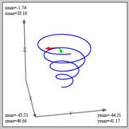
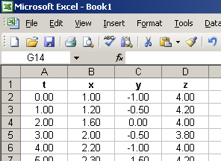

Particle motion is represented in three compatible ways
Winter 2013
Equations
Graphs
Tables
Practical utility
“Mind of God”
“Get ‘er done”
Deeper understanding

Slide 4

Some terminology…
Winter 2013
To define position, we must have in mind a reference frame
  These numbers are meaningless in themselves – they only get their context relative to the frame
Displacement is change in position
Velocity is the rate of change in position (take into account both direction and speed):

Slide 5
We must learn to understand changes in velocity
Winter 2013
For example, simple movement from here to there involves three steps
  Change velocity from zero to something
  Movement under constant velocity
  Change velocity from something back to zero
Calculating average velocity is usually not simple
  2 hour at 30 mph + 1 hour at 60 mph = 40 mph
  Total distance divided by total time

Slide 6
Question
Winter 2013
A driver speeds past a police man at 100 mph. Suppose the police man has a five second reaction time.
How fast must he travel (on average) to catch up to the speeding vehicle in order to catch it within 60 more seconds?
Answer: 54.2 m/s

Slide 7
We can answer this question in three different ways
Winter 2013
Equations
Graphs
Tables
Show me

Slide 8
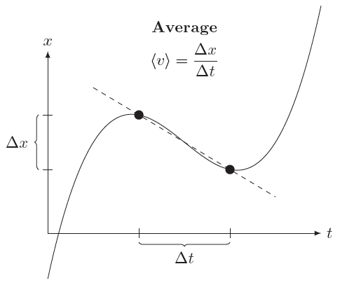

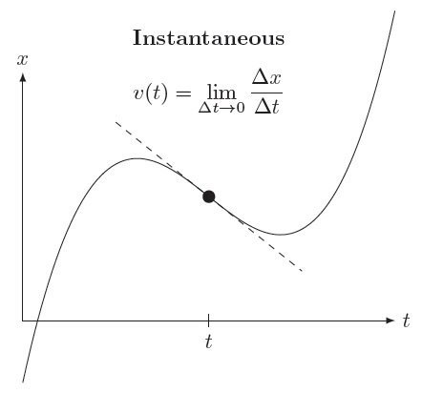

In general, velocity is not constant
Winter 2013

Slide 9

Acceleration is the rate at which velocity changes
Winter 2013
Therefore acceleration comes from either
  Change in speed
  Change in direction
Rapid change involves large acceleration
There are two “natural” ways to measure it
  Relative to reference frame (easier to do)
  Relative to velocity (easier to understand)

Slide 10
In free-fall, objects experience constant acceleration
Winter 2013
The acceleration due to gravity (weight) is a relentless constant downward pull
The rate of change is 9.8 m/s² and labeled “g”
  Every second, an object increases its speed downward almost 10 m/s
  If moving up, the object’s speed decreases almost 10 m/s each second
At the top, the acceleration is still there:

Slide 11

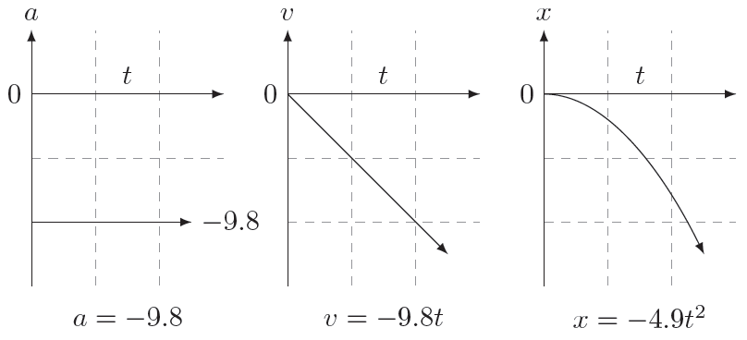
Constant acceleration yields time-squared motion
Winter 2013
The formula is:

Slide 12




Five equations of constant acceleration
Winter 2013
Show me

Slide 13

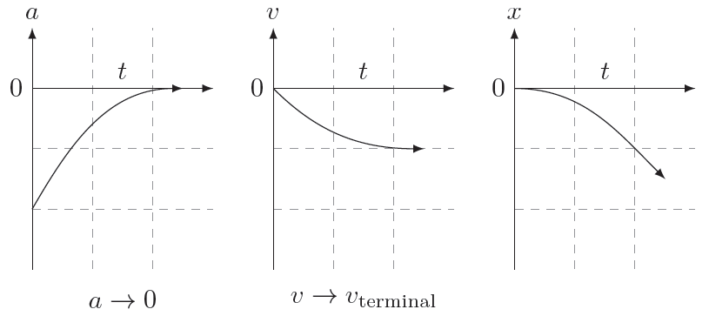
Including air drag is a completely different story
Winter 2013
if slow or small
otherwise

Slide 14
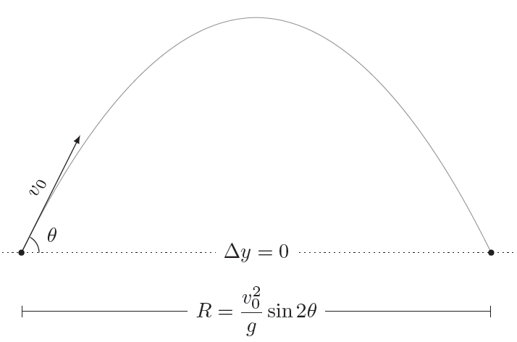
Projectiles: horizontal motion with vertical acceleration
Winter 2013
Show me

